Slide 1

ENGINEERS ACADEMIA
Presented By
K.Pranathi (10B61A0563)
K.Naveen (10B61A0564)
P.Pooja (10B61A0596)
V.Prudhvi (10B61A05C0)
Under the Guidance of
Amar Jukuntla, M.Tech.,
Assistant Professor
Department of Computer Science and Engineering
Nalla Malla Reddy Engineering CollEGE
Notes:
<number>

Slide 2
Agenda
Introduction
Literature Survey
Objectives of Engineers Academia
MVC Architecture
Snap Shots
Conclusions
References

Slide 3
Introduction

Slide 4
It’s an online network that allows people to connect with one another, usually with the intention of collaborating on and advancing research. The network has been described as mash up of Facebook, twitter and LinkedIn includes profile, pages, comments, groups, job listings and like follow buttons.

Slide 5
Literature Survey

Slide 6
History of engineering:
An engineering education is based on a strong foundation in math and science. Additional courses emphasize the application of this knowledge to a specific engineering field.
Sustainability:
The mission of Academic Sustainability Programs is to support and encourage interdisciplinary teaching and research programs that incorporate sustainability principles in all academic units on campus.
Civil Engineering:
Civil engineering is a broad field that encompasses the planning, design, construction and maintenance of fixed structures, or public works, as they relate to earth, water or civilization and their processes.

Slide 7
Inspiration:
Engineers Academia would be too simplistic to think of it just as a Facebook or LinkedIn for academics. Other additions to the site are a discovery tool, which provides the related search data that will be helpful to certain members.
Mechanical Engineering:
A mechanical engineer working at a tool company may design and build the automated machines used to assemble products. These automated machines are the tools that other engineers need for their work.
Electrical Engineering:
Electrical engineering comprises the study and application of electricity, electronics and electro magnetism. Electrical engineering is a field of engineering that generally deals with the study and application of electricity, electronics, and electromagnetism

Slide 8
Functionalities

Slide 9
Authentication
through Google

Slide 10
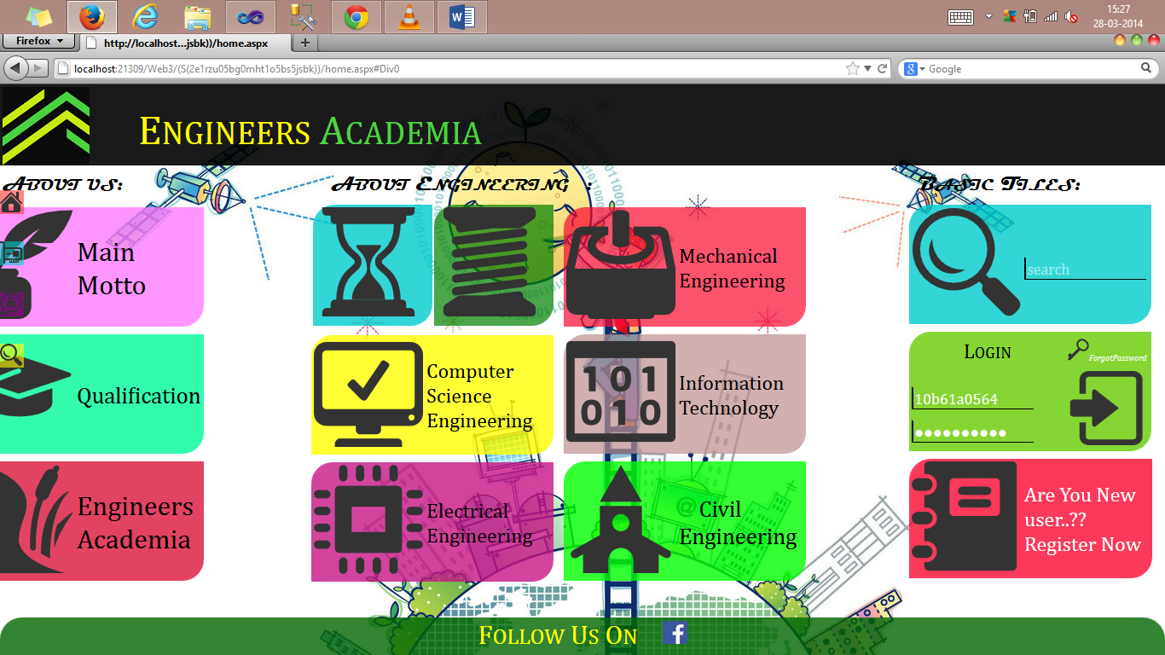

Slide 11
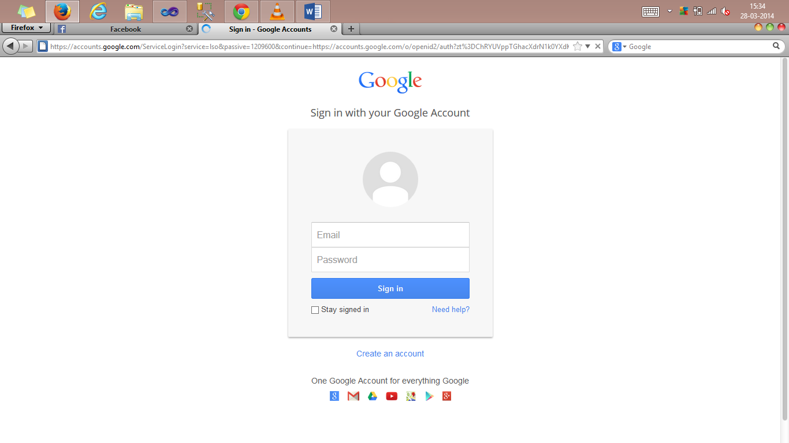

Slide 12
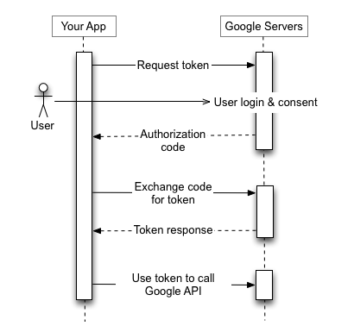

Slide 13
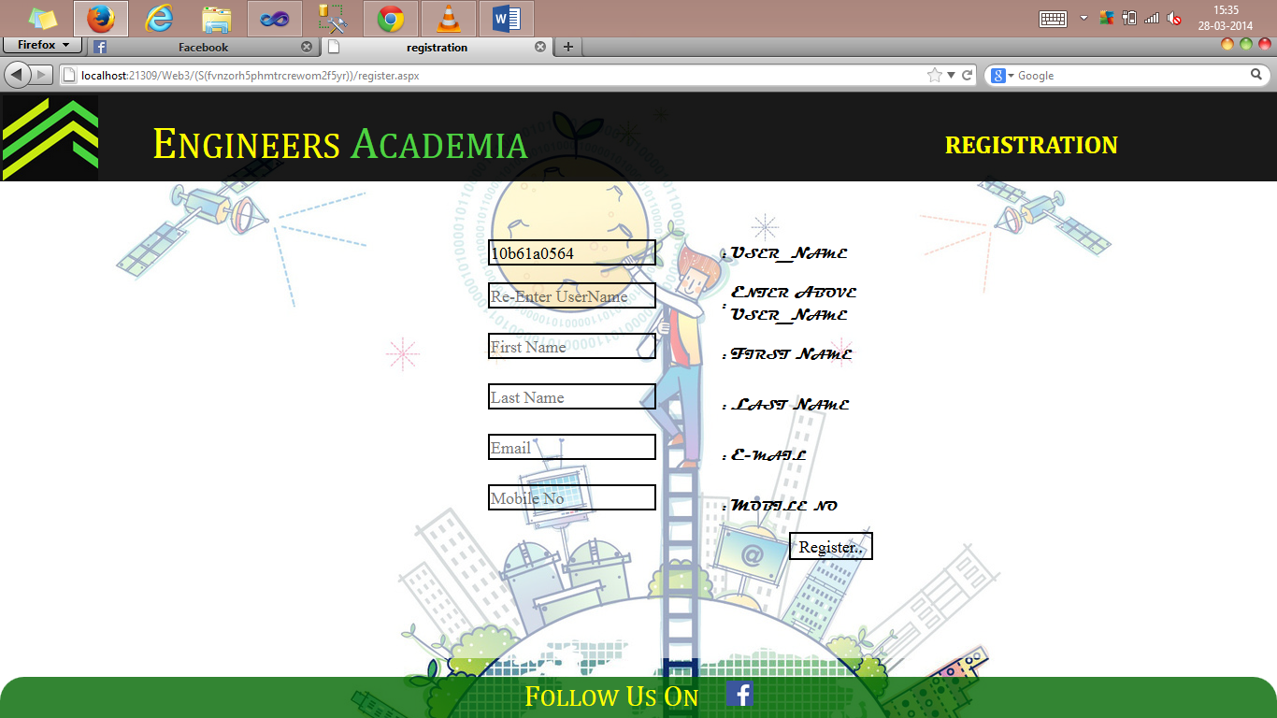

Slide 14
Encrypted passwords

Slide 15
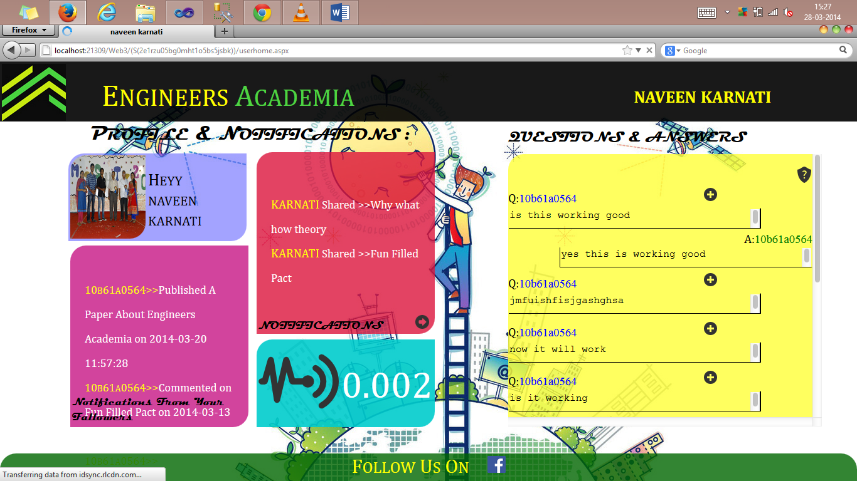

Slide 16
Google Search
Included in homepage

Slide 18
Share Research Work

Slide 19
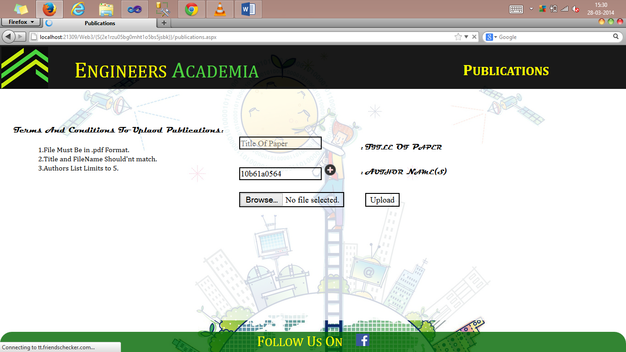

Slide 20
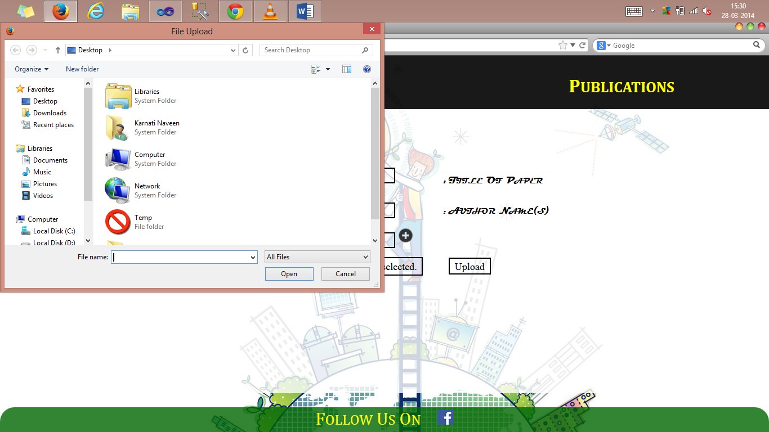

Slide 21
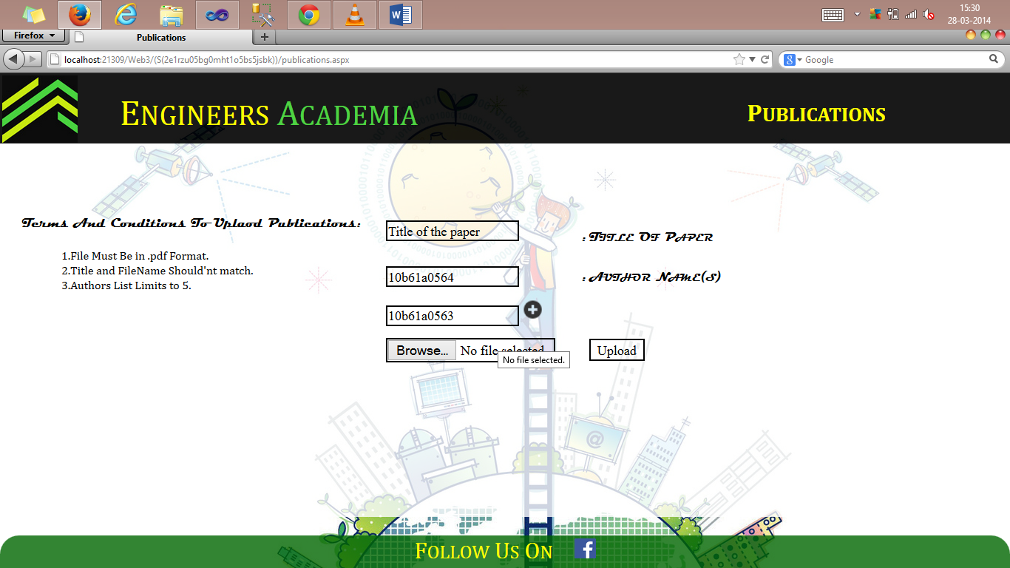

Slide 22
Notifications Of
New Publications

Slide 23
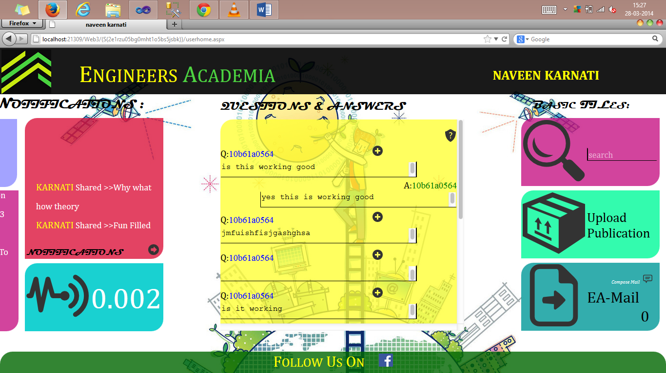

Slide 24
Notifications Of
Peoples’ Activity

Slide 26
Search for Specific
user or a publication

Slide 27
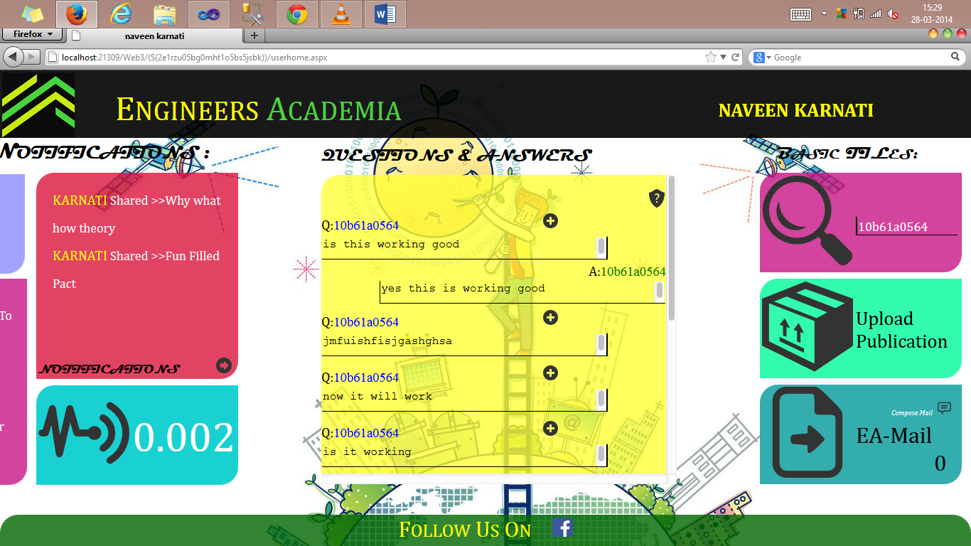

Slide 28
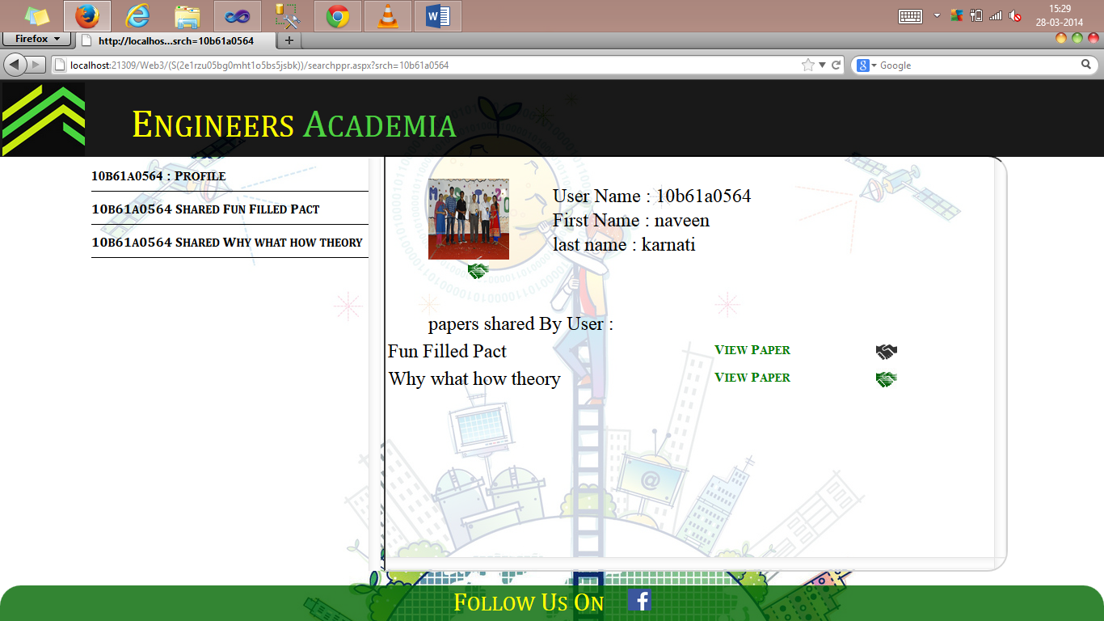

Slide 30
Communication within EA
Through EA-Mail

Slide 31
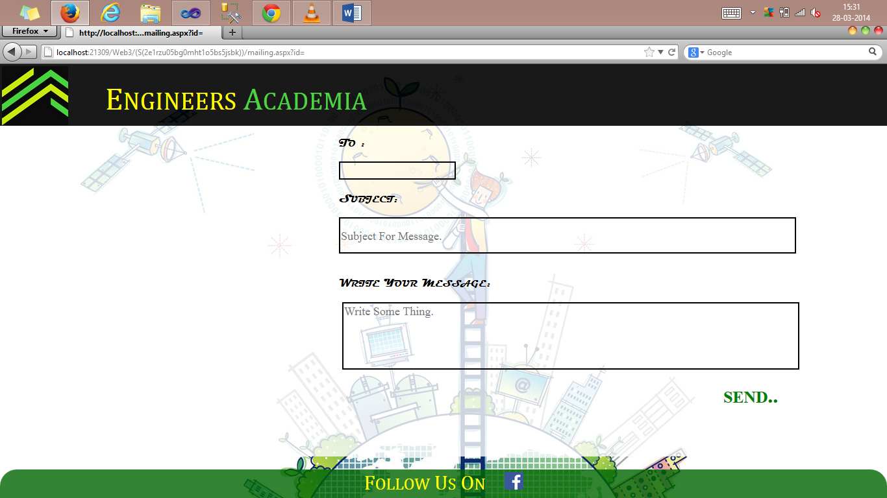

Slide 32
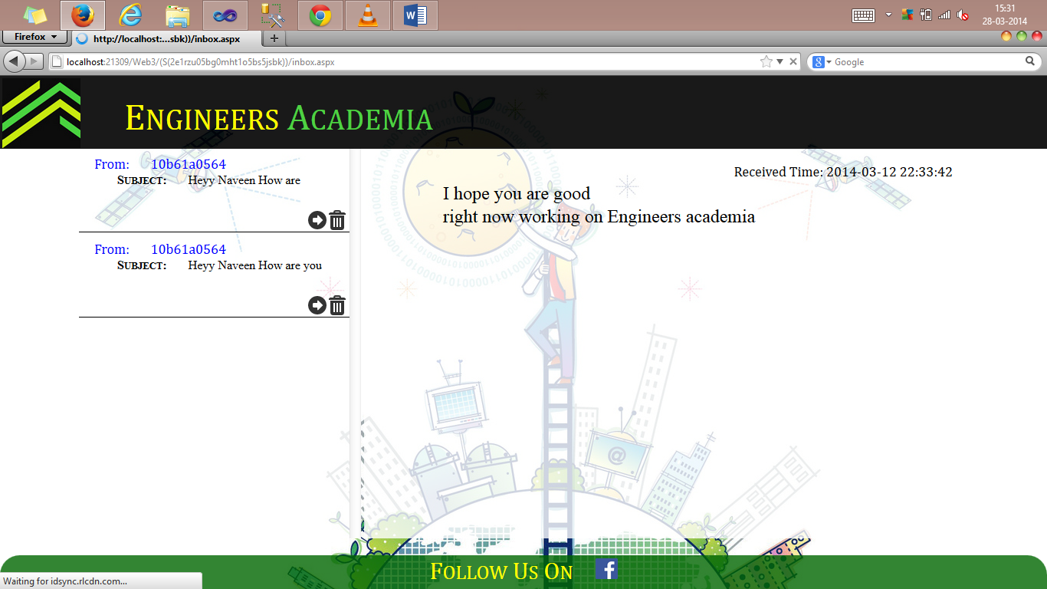

Slide 33
Share views on the papers
in the form of comments

Slide 34
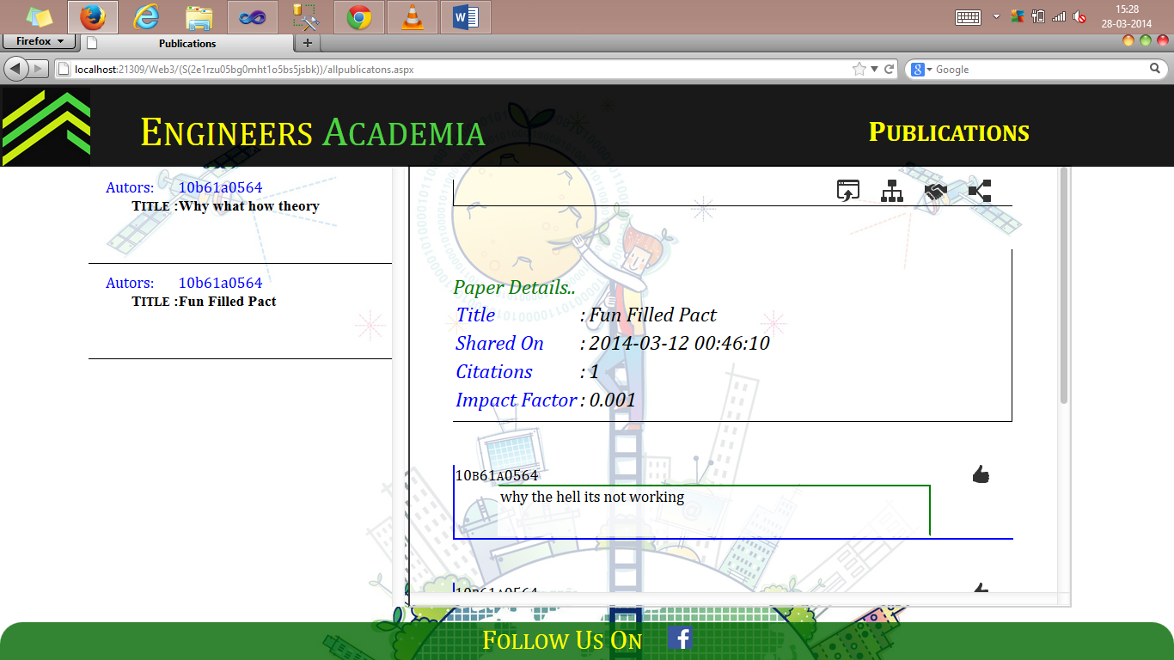

Slide 35
User can update
his/her details

Slide 36
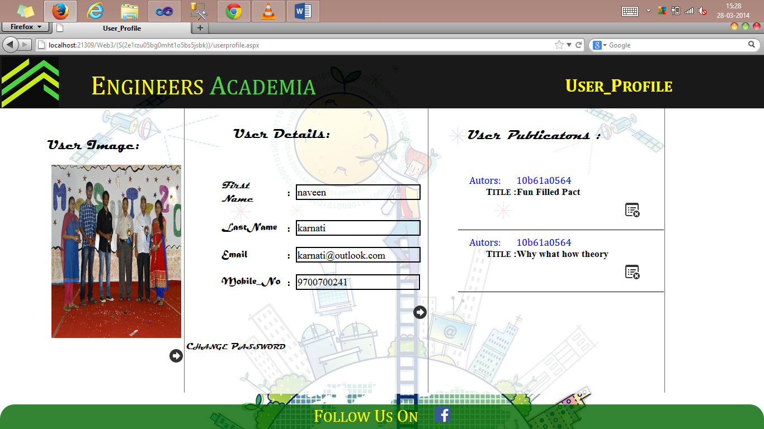

Slide 37
Algorithm
Impact Factor Algorithm

Slide 38
To calculate the EA value
EA = V/100+P/50+F/100
Where
V = number of Votes
P = number of Publications
F = number of Followers
If the EA value is greater than 5
then
EA=0.001 (initial)
IF of User =sum(IF of all Publications)

Slide 39
Difference
Existing System:
In this network only the verified users of the academy are allowed to use where it is Two way Authentication through Google .
Proposed System:
It is a network of a particular organisation so it doesn’t require any verification other than the google account provided by Organisation to user.

Slide 40
Objective of Engineers Academia

Slide 41
The main objective of Engineers Academia which is an online network is to allow people to connect with one another, usually with the intention of collaborating on and advancing research.

Slide 42
MVC ARCHITECTURE

Slide 43
1) MODEL: The model object knows about all the data that need to be displayed. It is model who is aware about all the operations that can be applied to transform that object.
2) VIEW: The view represents the presentation of the application. The view object refers to the model. It uses the query methods of the model to obtain the contents and renders it.
3) CONTROLLER: Whenever the user sends a request for something then it always go through the controller.

Slide 44













ADO.NET
ASP.NET
Web
Container
Folders

Slide 45
Conclusion

Slide 46
With this academia the members can automatically subscribe to a co-author’s feed, so they can see, work from and connect with their co-author’s.

Slide 47

Enhancement

Slide 48
References

Slide 49
Researchgate.org
Google.com
Why is Engineering??
W3schools.com for CSS style sheets
http://social.msdn.microsoft.com/Forums/en-US/ce4bdc40-6955-4e06-a7a5-41ae5135027a/connecting-ms-access-database-in-c
http://msdn.microsoft.com/en-us/library/ms228504.aspx
http://www.mindstick.com/

Slide 50
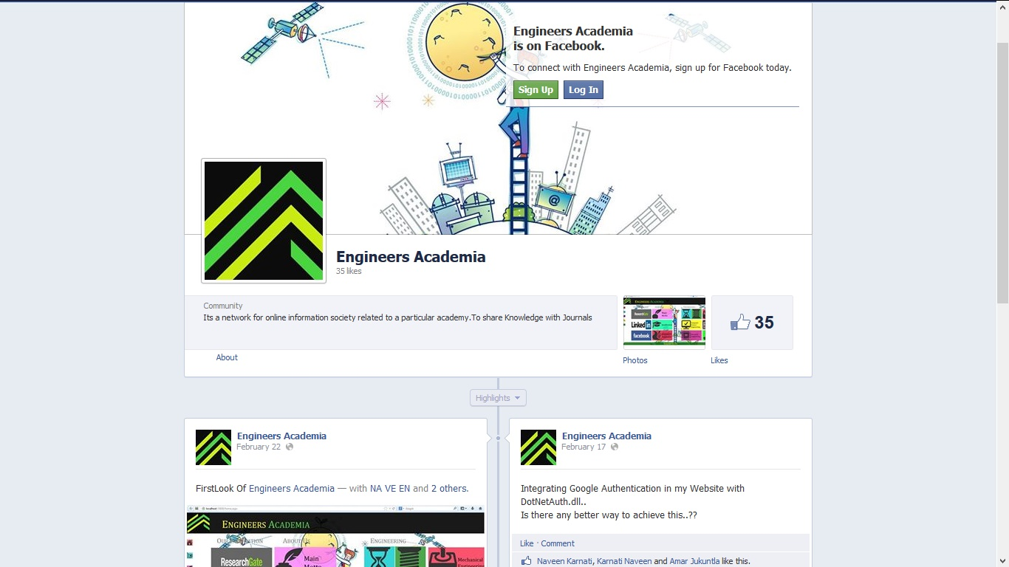
And Finally If you want to Fallow Us

Slide 51

Queries??

